Slide 1

Manufacturing
10-9-2019

Slide 2
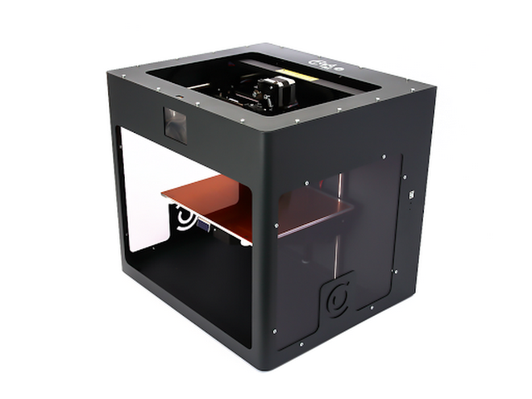
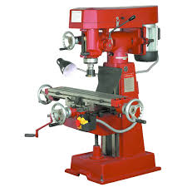
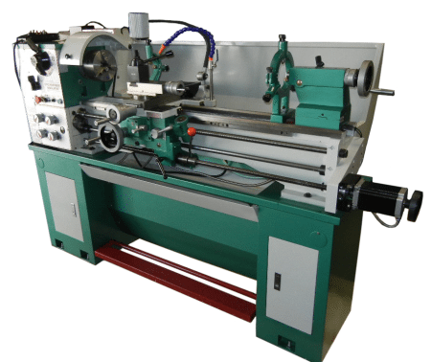
Manufacturing

Slide 3
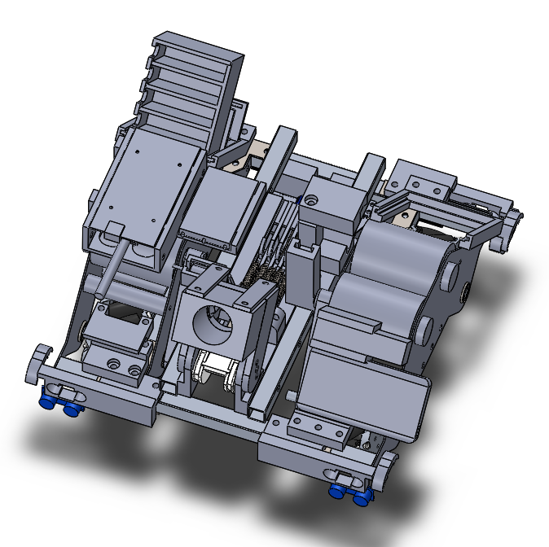
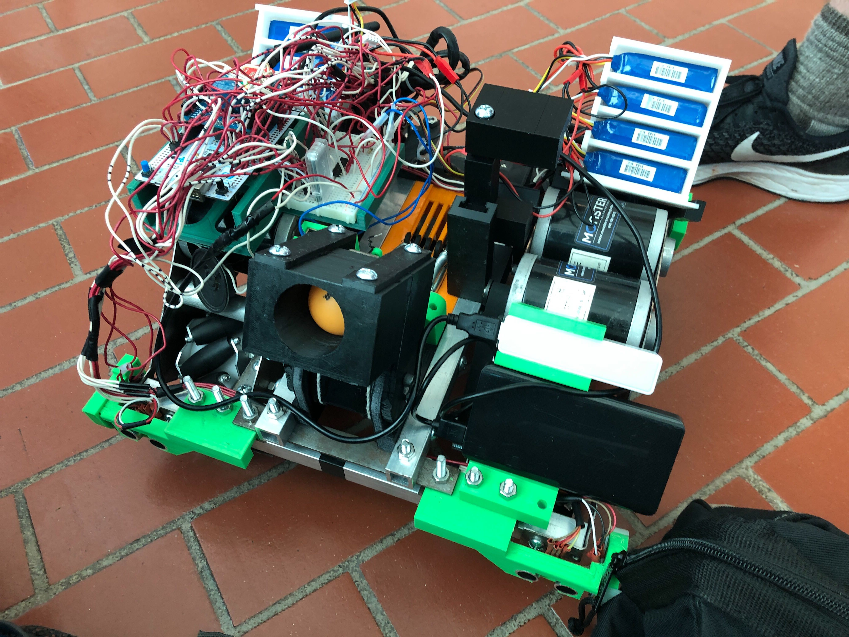
Turning a Design into Reality

Slide 4
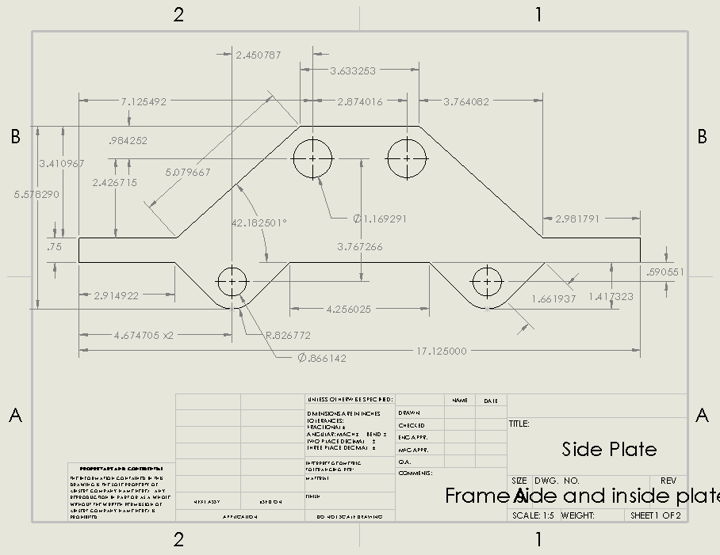
Dimensioned Drawings

Slide 5

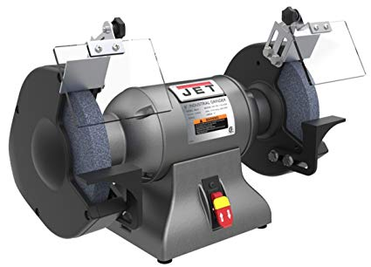
Working with Metal
Angle Grinder
Bench Grinder

Slide 6
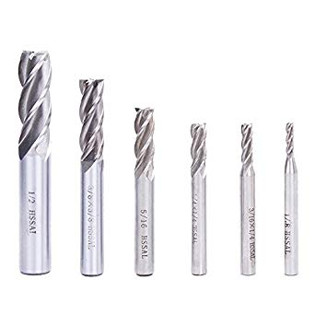
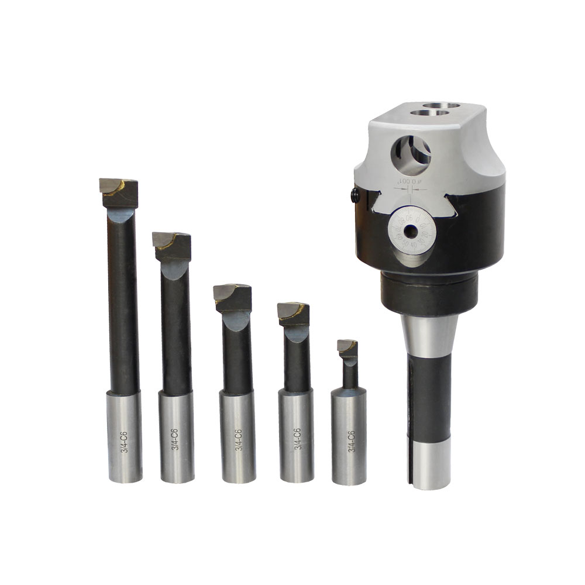
Milling Machine
Boring Bar
Milling Machine
End Mill

Slide 7
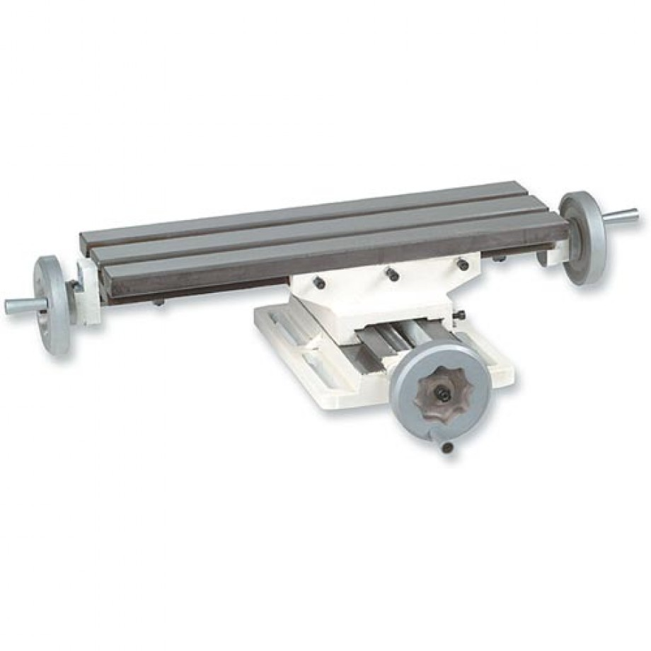
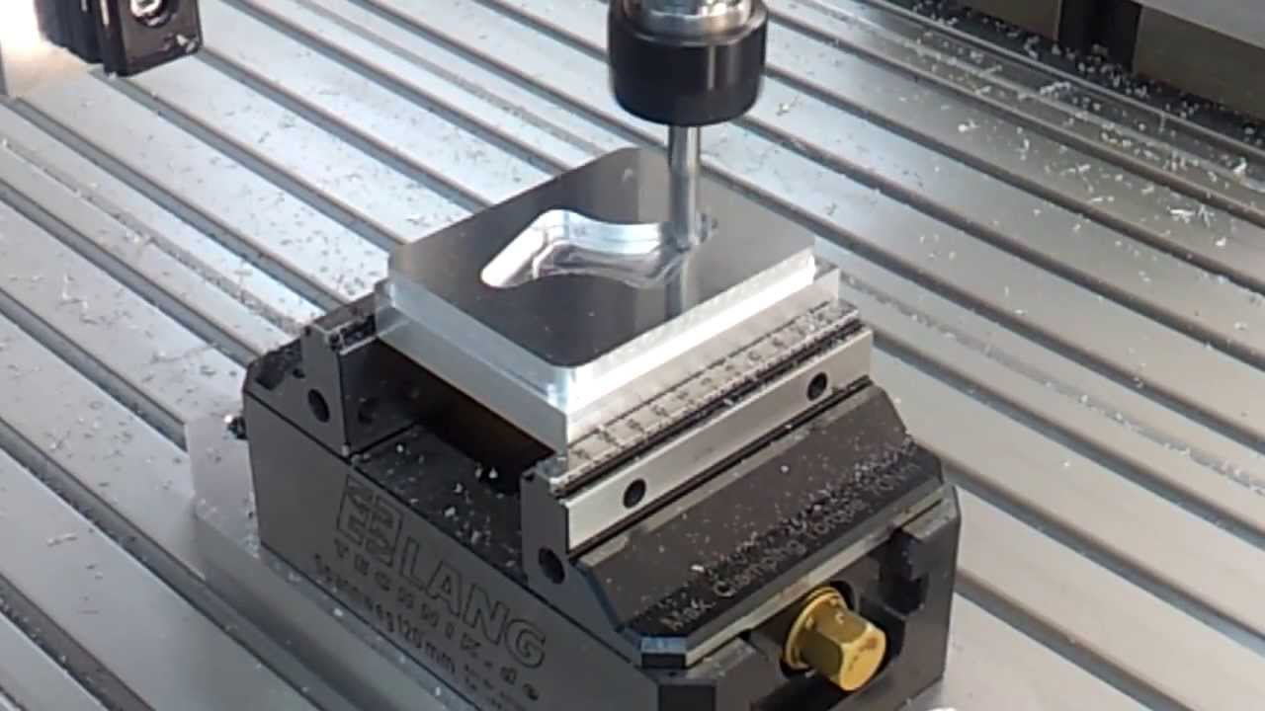
The Milling Process
Cutting a Part
Machine Table

Slide 8
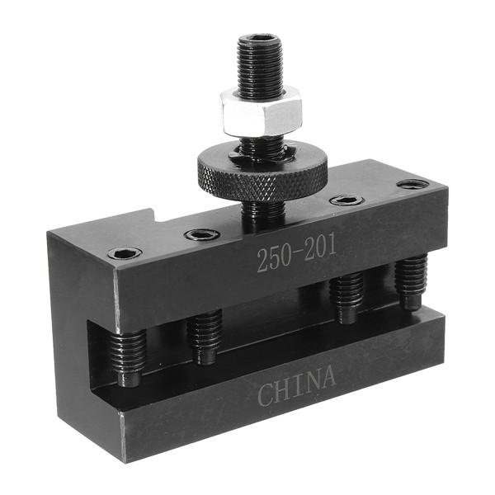
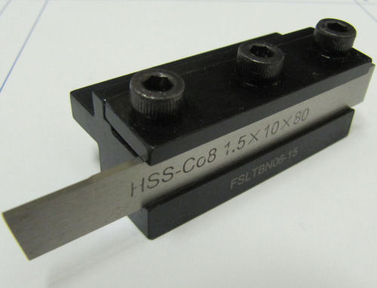
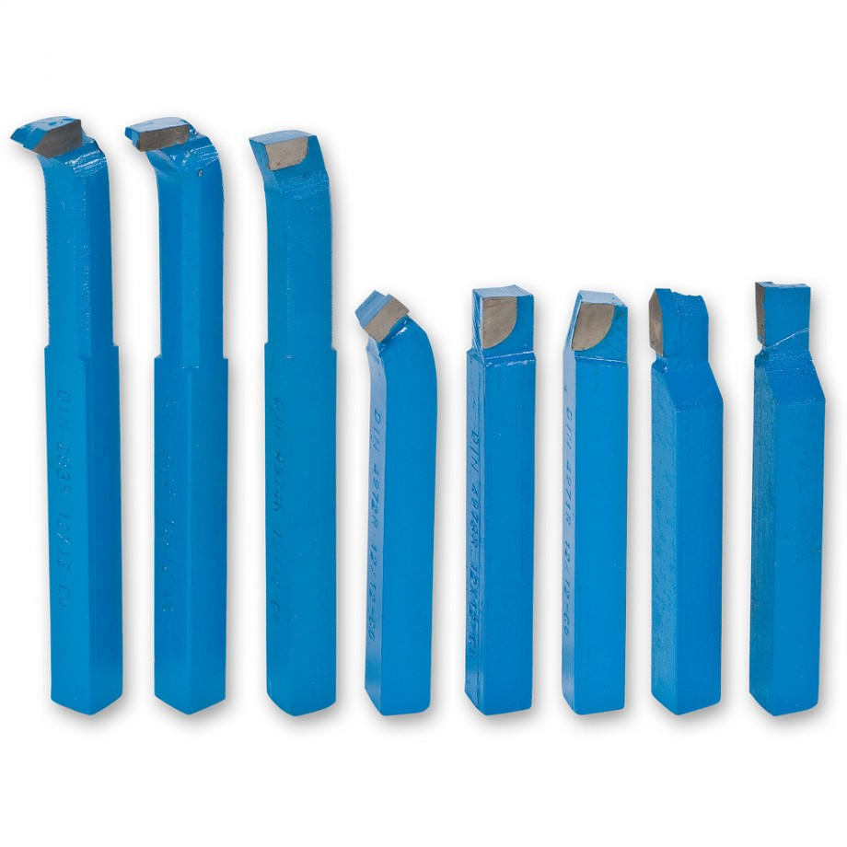
Lathe
Parting tool
← Cutting Tools

Slide 9
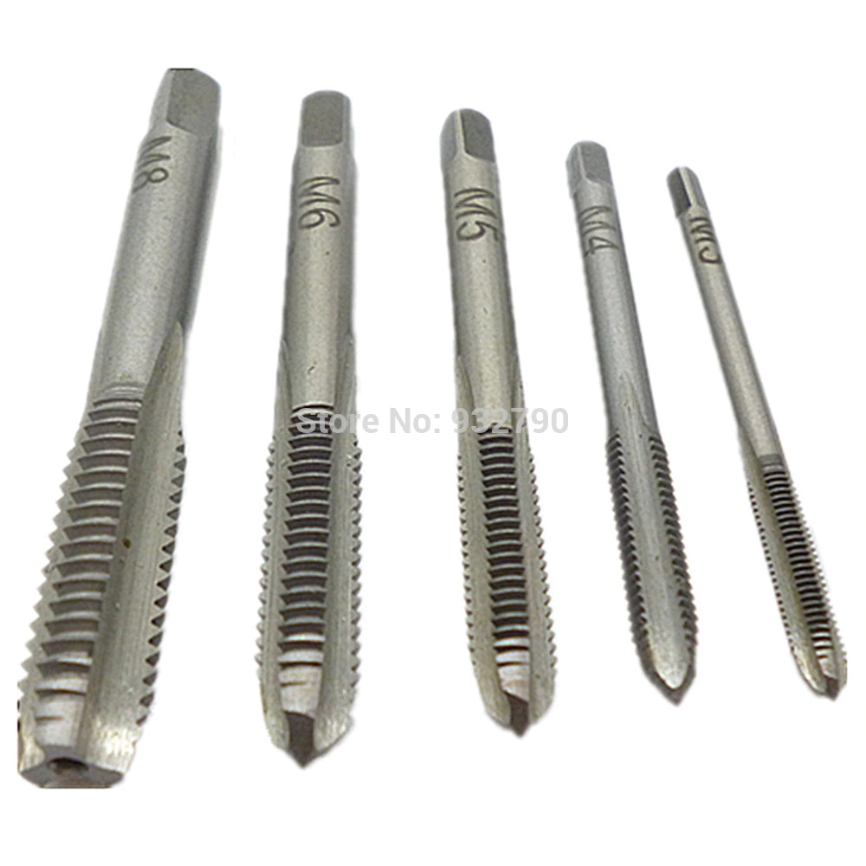
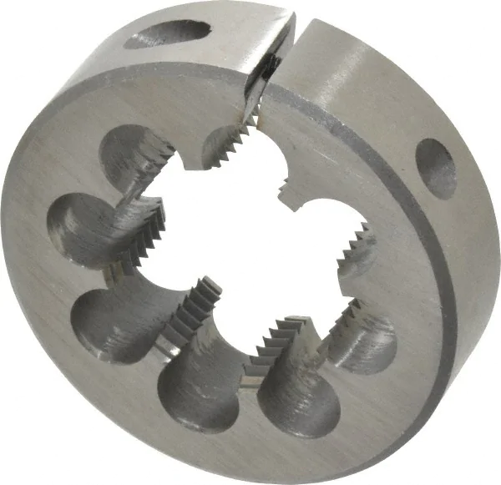
Thread Cutting Tools
Thread Tap
Thread Die

Slide 10
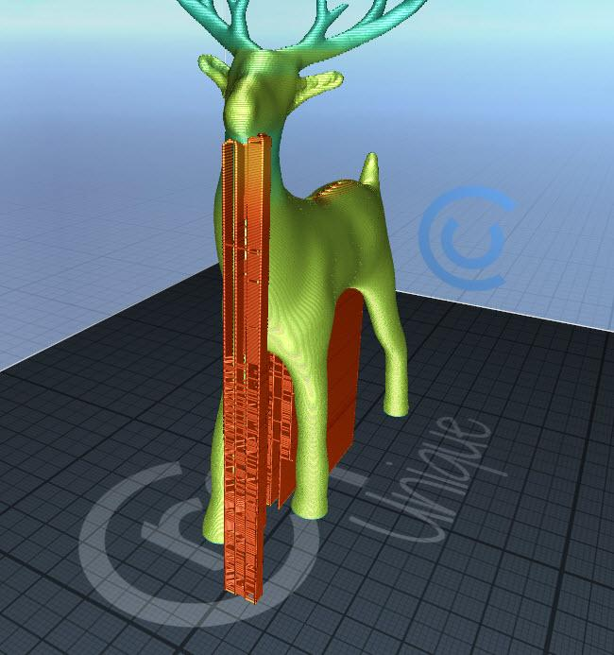
3D Printing

Slide 11

Manufacturing Options
Machining:
North Campus Labs
Endeavor - Plastic only
3D Printing:
Endeavor
Library
Parker Hall

